Slide 1


human computer interaction Lecture 1&2
BS-CS-VII

Slide 2
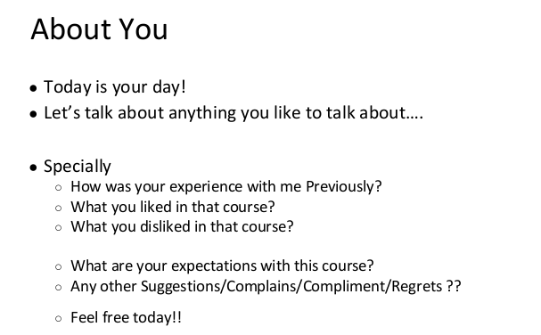
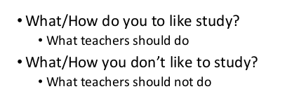

Slide 3
Outline
Introduction
Class rules
Marks distribution
Grading policy
Course portal
Course learning outcomes
Basics of HCI

Slide 4
Introduction
Joined Sukkur IBA University in August - 2017
Bachelor BS-CS- Software Engineering 2016
MS (CS), Shah Abdul Latif University, Pakistan, 2022
MPM (Masters in Project Managment) SZABIST 2022
How to reach me?
noornabi@iba-suk.edu.pk

Slide 5
Class Rules [1/2]
Be punctual
Late comers are not allowed
85% attendance
Be attentive
You pay to listen
I get paid to speak
Be prompt
Be always ready to learn
Class participation is important
Surprised quizzes

Slide 6
Class Rules [2/2]
Be polite
Be a soft-spoken person
Do not laugh on fellow’s questions
Be honest
Do your work by yourself
Do properly credit other’s work
Cheating is an academic offense (zero marks)
Do not waste others’ time
Be responsible
Switch off your cell phone
Penalty: treat for the whole class

Slide 7
Grading Distribution
Midterm 30%
Sessionals 20%
Quiz 5%
Assignment 5%
Case Study 5%
Project/Presentation 5%
Final 50%

Slide 8
Grading Policy
No best quiz/assignment
No make up (even for sessional exams)
Regular assignments
Strict submission deadlines
Zero marks for the copied quizzes/assignments

Slide 9
Course Learning Outcomes
Upon completion of the course, students will be able to:
Explain human factors of HCI including human body physical abilities, ergonomics, accessibility, health issues, cognitive load and psychology.
Explain hardware factors of HCI including different input and output devices e.g. keyboard, mouse, and touchscreen.
Understand different key elements from which user interfaces are constructed.
Implement user-centered approach in software development process and apply suitable techniques for collecting user requirement and analyzing task.
Evaluate and compare user interfaces using different techniques such as laboratory experiments and expert reviews.

Slide 10
Recommended Resources
Text book
Designing Interactive Systems: A comprehensive guide to HCI, UX and interaction design, D. Benyon, 3rd edition, Pearson Education, 2013.
Other
Human Computer Interaction, A. Dix et al., 3rd edition, Pearson Education, 2003.
Designing the User Interface: Strategies for Effective Human-Computer Interaction, B. Shneiderman et al., 5th edition, Pearson Education, 2009.
The essence of human computer interaction, C. Faulkner, 1st Ed.
The design of everyday things, D. Norman, 2nd Ed.
http://hcibib.org/

Slide 11
Different Terms Used
Human Computer Interaction (HCI)
Computer Human Interaction (CHI)
Man Machine Interaction (MMI)
Human Machine Interaction (HMI)
Interaction / Interface

Slide 12
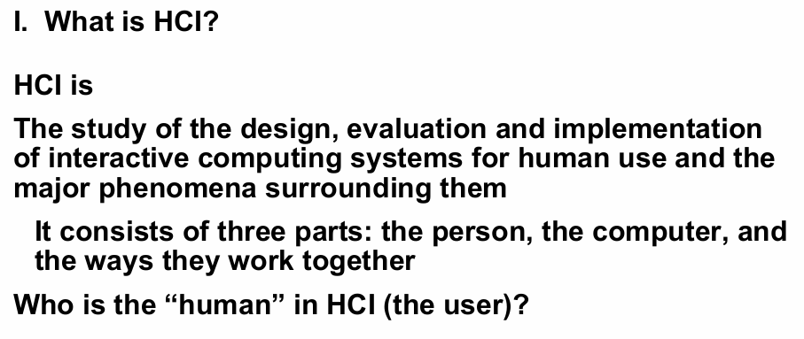
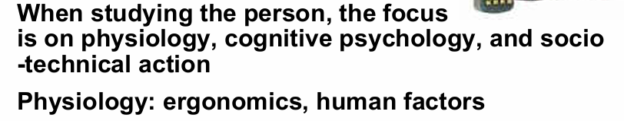

Slide 13
Component of HCI [1/2]
Human
Single user
Multiple users
Computer
Desktop/laptop/PDA/mobile devices
Microwave oven
Interaction
Direct interaction
Indirect interaction

Slide 14
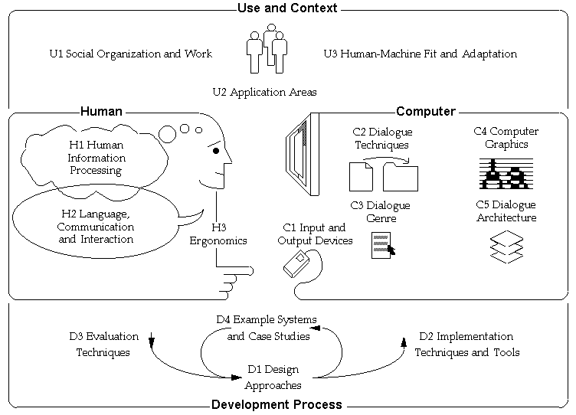
Human Computer Interaction [2/2]

Slide 15
ACM SIGCHI Definition [1992]
ACM SIGCHI is the leading international community of professionals interested in research, education and the practical application of human-computer interaction.
Human-computer interaction is a discipline concerned with
the design,
evaluation
and implementation of interactive computing systems
for human use
and with the study of major phenomena surrounding them.
ACM (Association for Computing Machinery)

Slide 16
Multidisciplinary
CS
AI
Anthropology
Ergonomics
Linguistics
Philosophy
Art
Sociology
Design
Psychology
Engineering
Physiology

Slide 17
Goals of HCI
Useful
Accomplish what is required
Play music, cook dinner, format a document
Usable
Do it easily and naturally
Without danger of error
Used
Make people want to use it
Be attractive, engaging, fun

Slide 18
Elements
✔ Typography – The style and arrangement of text.
✔ Color Theory – Choosing colors that evoke emotions and fit the brand.
✔ Layout & Composition – Arranging elements for balance and readability.
✔ Imagery & Icons – Using visuals to convey meaning.

Slide 19
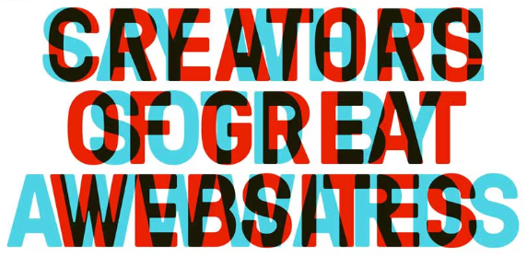
Can you tell what this home page is trying to say? No?

Slide 20
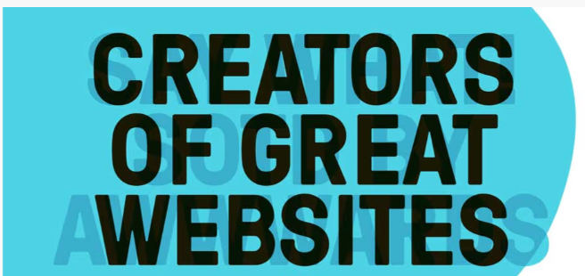
Is this a clever design? Yes, definitely. But is this bad design? Absolutely!

Slide 21
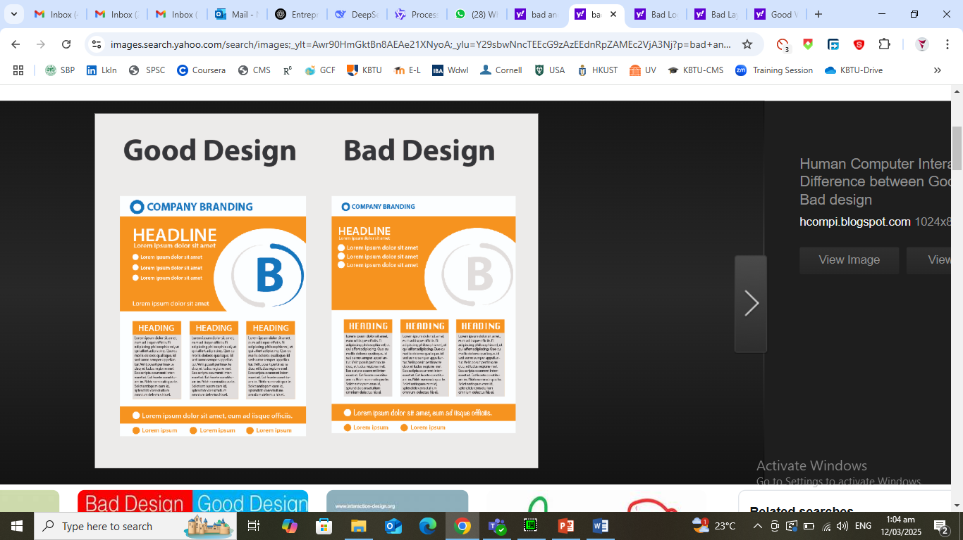
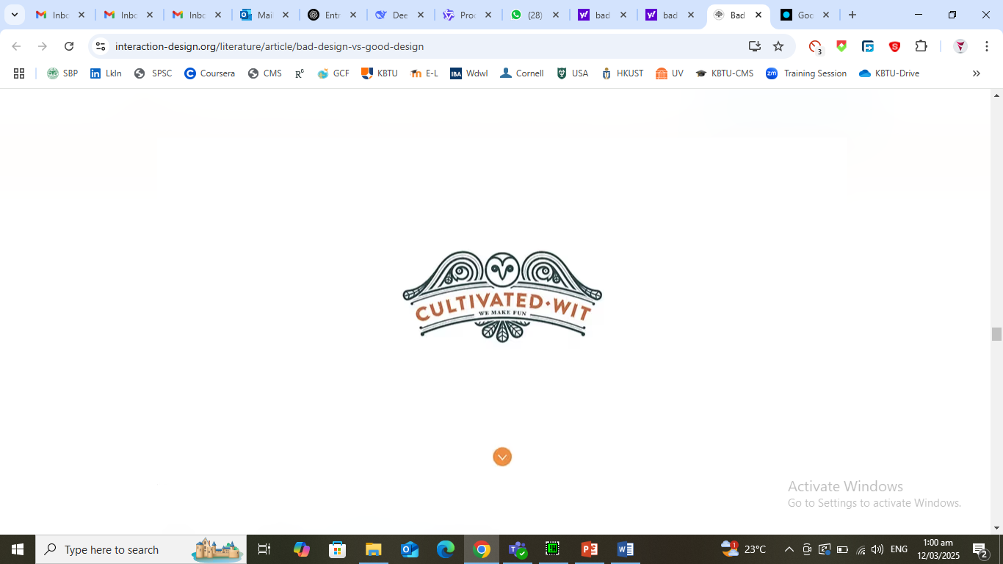


Slide 22
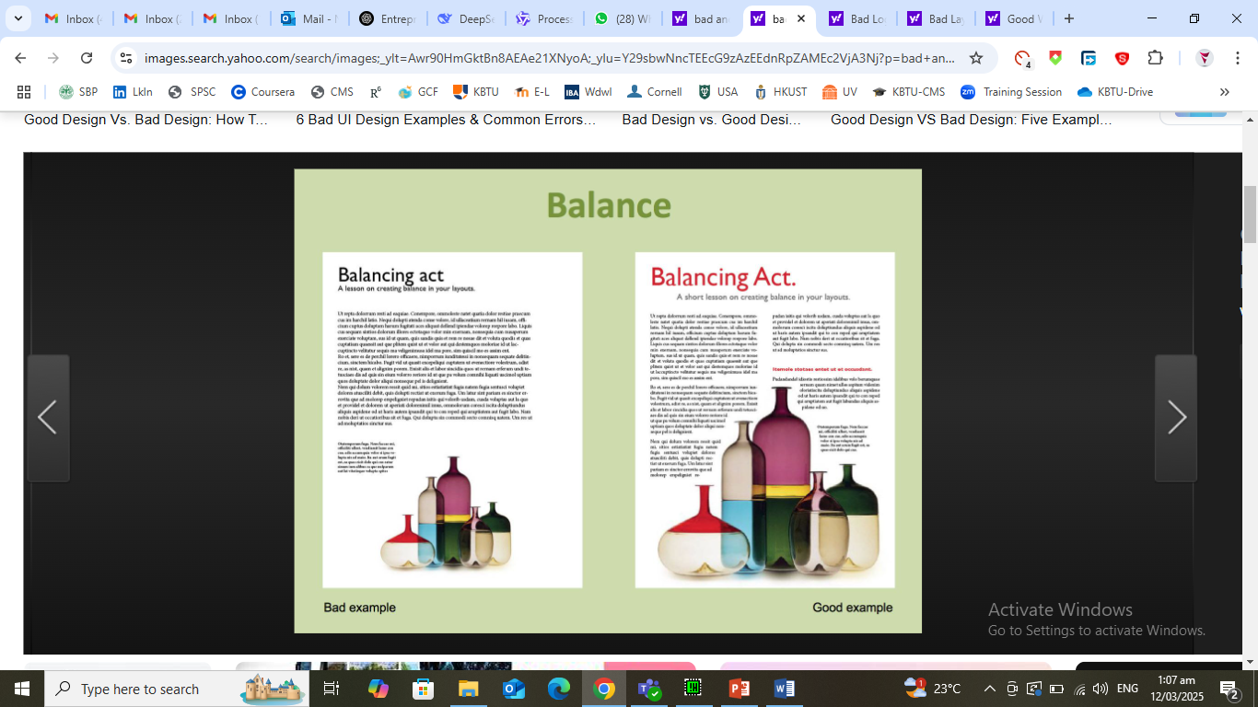

Slide 23
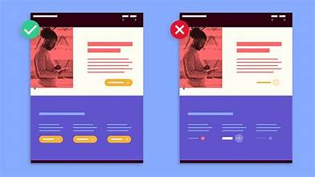

Slide 24

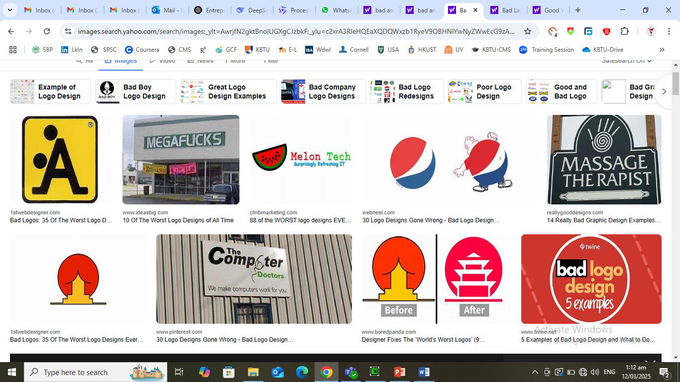


Slide 25
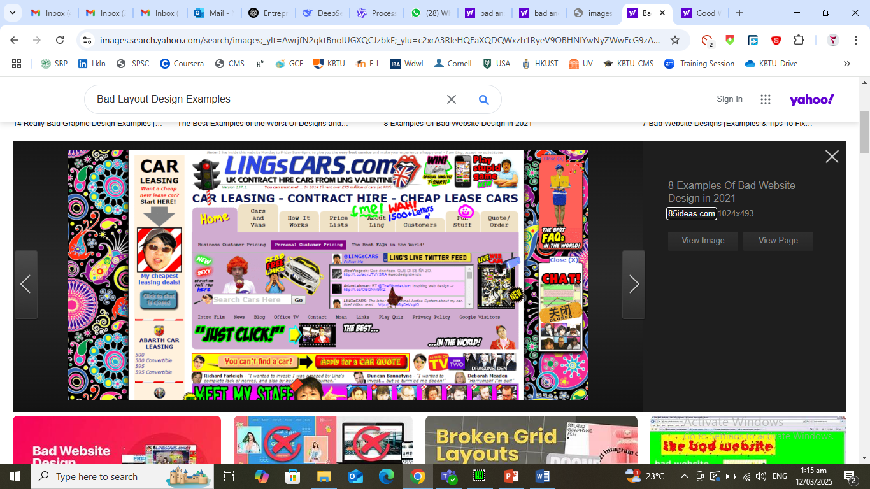

Slide 26
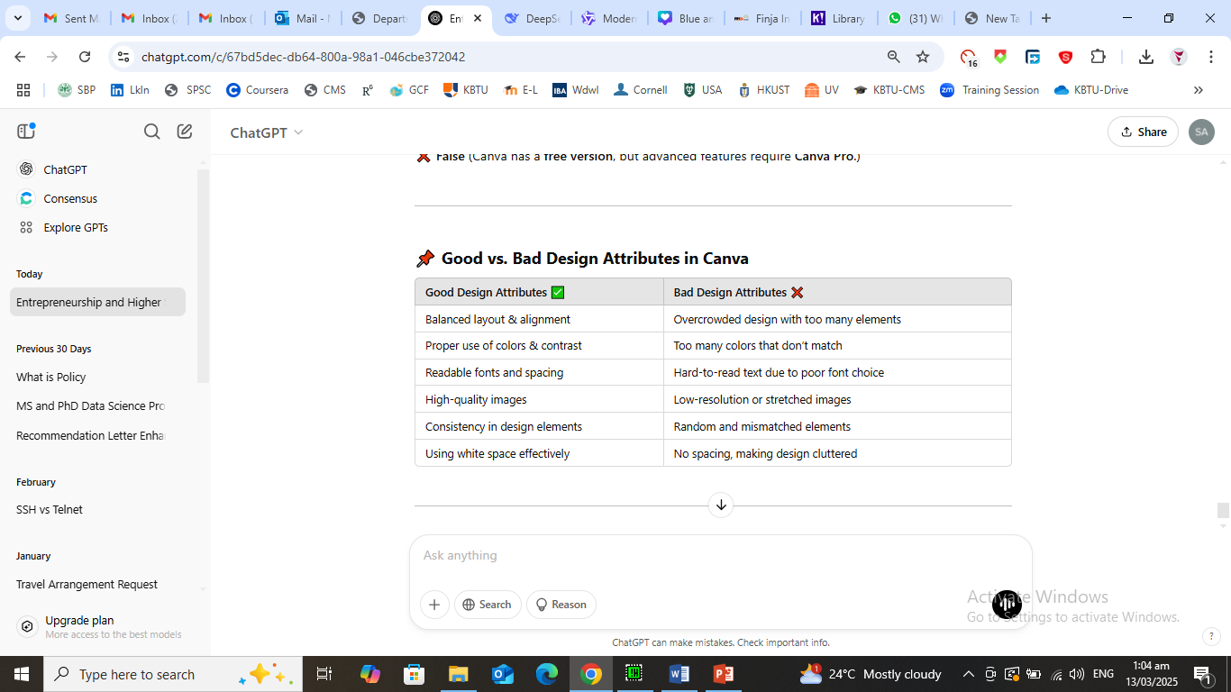

Slide 27
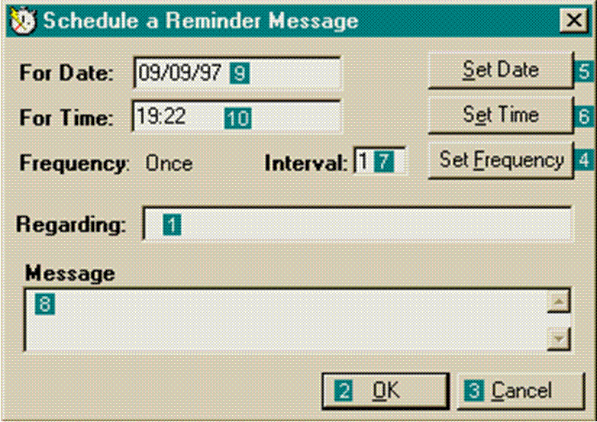
Why Study HCI – Software Perspective [1/3]

Slide 28

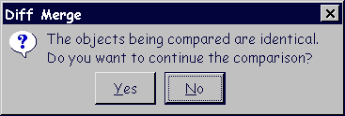
Why Study HCI – Software Perspective [2/3]

Slide 29
Why Study HCI – Software Perspective [3/3]
Your task
Give few examples
www.baddesigns.com
Google interface hall of shame

Slide 30
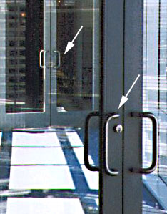
Why Study HCI – Non-Software Perspective [1/5]
Push/pull trap

Slide 31
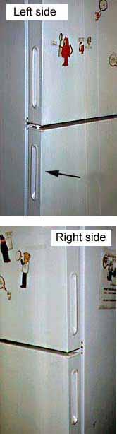
Why Study HCI – Non-Software Perspective [2/5]
Which side to open

Slide 32
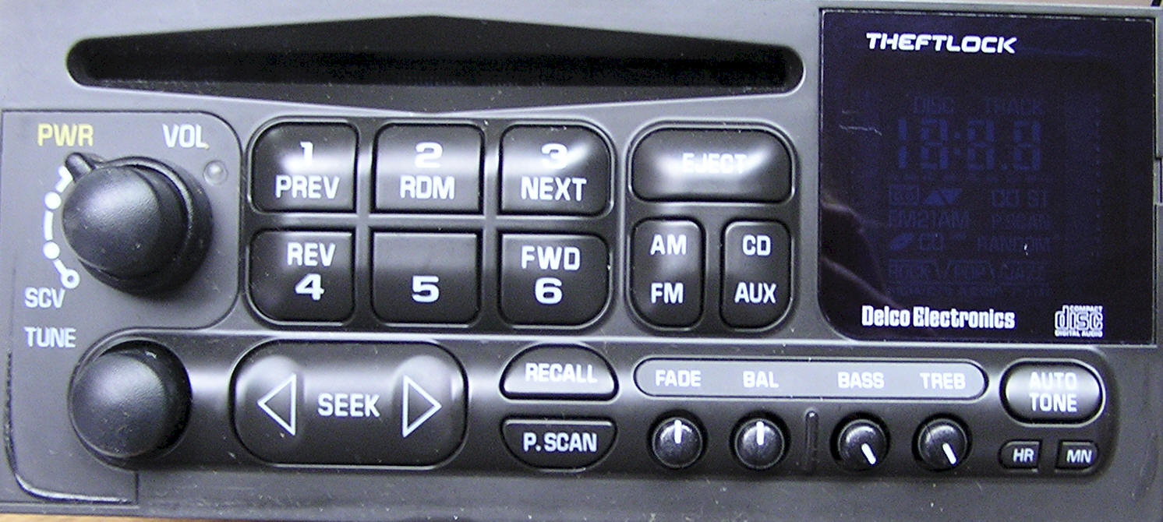
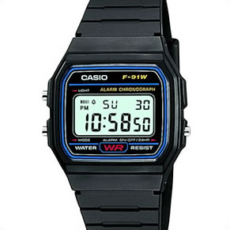

Why Study HCI – Non-Software Perspective [3/5]
Car Radio
VCR
Digital watch

Slide 33
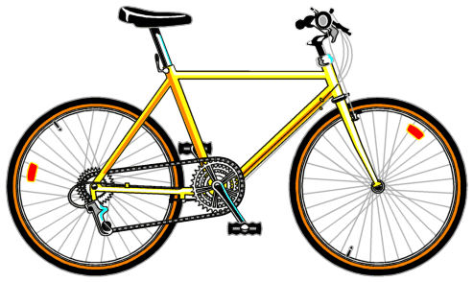
Why Study HCI – Non-Software Perspective [4/5]
Human interaction with bicycle
Handle bar
Brake control
Seat
Foot pedals
If it is not properly designed

Slide 34
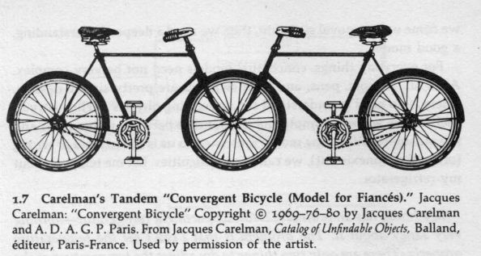

Why Study HCI – Non-Software Perspective [5/5]

Slide 35
Why Study HCI – Conclusions [1/2]
Few attempts to use any product
If not successful
Loses hope
Gives up
What are the consequences?

Slide 36
Why Study HCI – Conclusions [2/2]
To develop products / interaction techniques
Easy to use
Easy to learn
Easy to remember
To design user friendly systems
Efficient
Avoid unnecessary complexity

Slide 37
Software Eng. VS HCI
Software Engineering
System-centered
Software architecture
Human Computer Interaction
User-centered
Users
Tasks
Context of use
procedural aspects

Slide 38
Some HCI Subjects
HCI (in general)
Usability eng./testing
User interface design
Human factors/Ergonomics
Web design/usability
Graphic design
Information visualization
Many more…

Slide 39
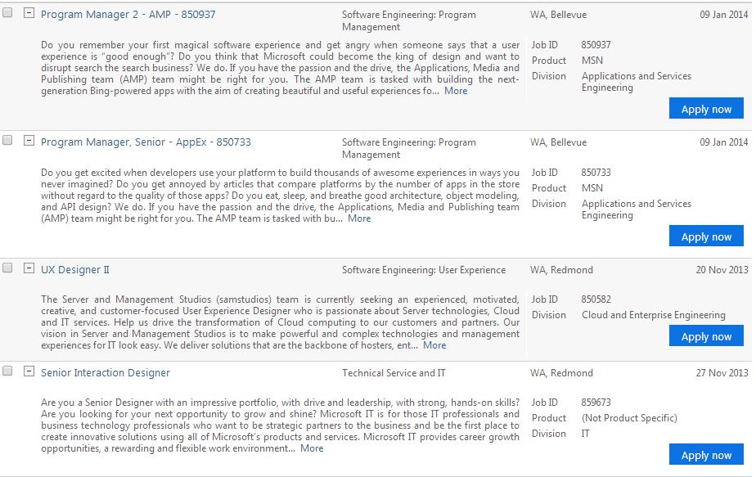
HCI Jobs
Is there any job for HCI experts? ☺

Slide 40
Plagiarism
What is it?
Positive reasons for not plagiarizing
Copying from single/multiple sources
Paraphrasing, collusion
How to avoid it?
Reference list VS bibliography
Plagiarism detection
Penalty

